Slide 1
Homlessness,Drug Addictions, Mental Health & Veterans
Devon Caballero-Zarate
SS320
Dr David Brokaw

Slide 2
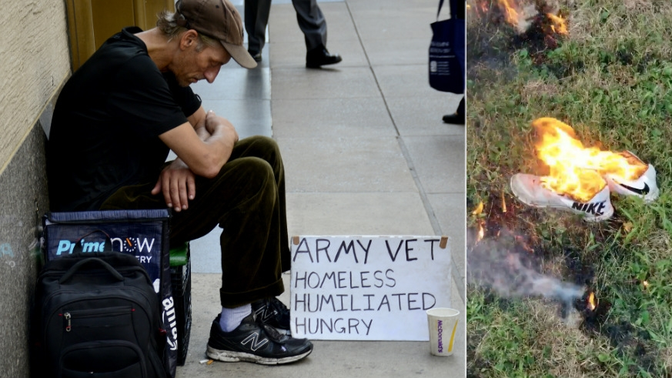
Homeless Vets
According to the U.S. Department of Veterans Affairs at any given time there are 131,000 homeless vets on the street and double that will be on the street at least one time throughout the year if not more.
Approximately 40 percent of homeless vets are men even though veterans only account for 34 percent of the total homeless population

Slide 3
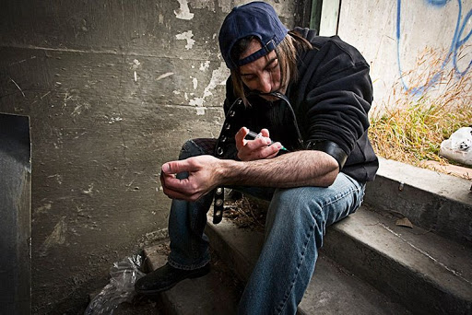
Veterans and Drugs
According to the Substance Abuse and Mental Health Administration 21 percent of all veterans who found their way into some type of substance abuse treatment were homeless
The poison of choice of most homeless veterans is alcohol, meth, heroin (shootable or prescription pill form), crack cocaine and fentanyl
The main causes of problems that lead to the addiction are the traumatic experiences that leave both physical and psychological scars

Slide 4
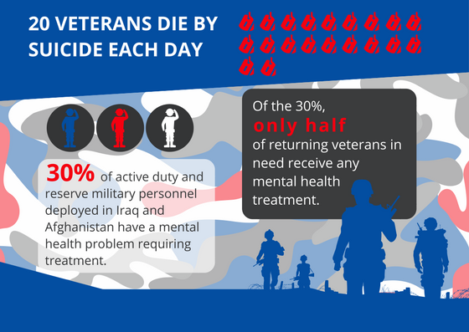
Veterans and Mental Health
According to the U.S. Department of Veteran Affairs over 80 percent of mental health issues
PTSD is one of the more prevalent but due the backlog of cases, most cant get care
Schizophrenia, Hallucinations, Personality Disorder, and IED are just a few of the severe and horrific diagnoses that our vets are hit with every day.
Also according to Military.com and US Department of Veterans Affairs, a minimum of 60,000 veterans between 2008-2017 have chosen the route of taking their own life due to improper care or a complete lack there of because the country they were willing to die for didn’t' give a damn about them.

Slide 5
Video Proof
https://www.youtube.com/watch?v=A5JILc50vnI

